Slide 1

Understanding the
Three Curriculum Strands
in Leaving Certificate
Physical Education

Slide 2

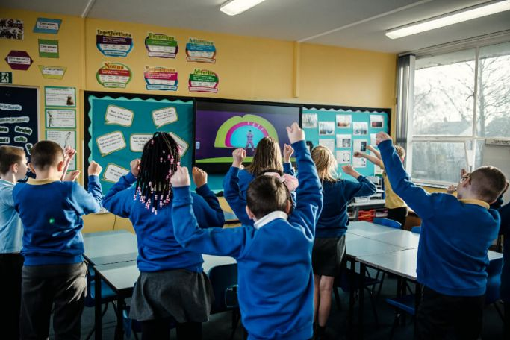
Welcome to Strand Breakdown
You are about to explore the three interconnected strands of Leaving Certificate Physical Education
Each strand builds your understanding of physical activity from different perspectives
Together, these strands create a complete framework for becoming an informed, skilled performer
You will discover how practical activities connect to theoretical learning throughout your course
Notes:
Image from: https://www.ajbsportsineducation.com/2019/11/08/how-can-physically-active-learning-help-my-school/

Slide 3
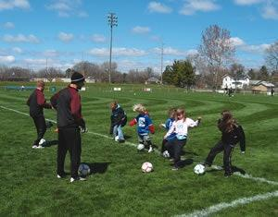
Strand 1:
Skill Learning,Participation & Performance
This strand focuses on how you develop movement competency and improve your performance
You learn about stages of learning, from beginner to advanced performer
Key concepts include skill development, technique analysis, and creative expression through movement
You explore how physical activity fits across different life stages and promotes inclusivity
Learning outcomes help you recognise characteristics of skilled performance and set personal goals
Notes:
Image from: https://www.athleticbusiness.com/operations/article/15141031/developing-sports-training-programs-for-youths

Slide 4
Strand 1: Key Learning Outcomes
You should be able to demonstrate and analyse skilled performance in selected activities
You can identify stages of learning and apply strategies for effective practice
You understand the difference between natural ability and learned skill
You can evaluate your own performance and set realistic improvement goals
You appreciate aesthetic & artistic dimensions of movement in various activities

Slide 5

Strand 2:
Physical & Psychological Demands of Performance
This strand examines what your body and mind need to perform at their best
You explore fitness components, training principles, and recovery strategies
Key concepts include nutrition, energy systems, and how your muscles and skeleton work
You learn about mental preparation, resilience, & psychological factors affecting performance
You understand structured training design and periodisation for optimal results
Notes:
Image from: https://www.pcmag.com/picks/the-best-heart-rate-monitors

Slide 6

Strand 2:
Key Learning Outcomes
You can explain components of fitness and how they apply to your chosen activities
You understand training principles and can design appropriate training programs
You know how nutrition and hydration support physical performance
You can analyse psychological factors that influence your practice and performance
You understand recovery strategies and injury prevention methods
Turn to a partner and discuss one fitness component you want to improve in your sport
Notes:
Image from: https://blog.nasm.org/sports-nutrition-guide

Slide 7
Strand 3:
Factors Influencing Participation in Physical Activity
This strand looks at the broader context of physical activity in society
You explore ethical considerations, fair play, and safe practices in sport
Key concepts include tactics, strategies, and the roles of coaches, officials, and choreographers
You examine how technology, media, sponsorship, and commercial interests shape physical activity
You consider how physical activity connects to health, wellbeing, and social responsibility

Slide 8

Strand 3:
Key Learning Outcomes
You can apply strategies and tactics effectively across different physical activities
You understand ethical principles including fair play and anti-doping regulations
You can explain the roles of officials, coaches, and other support personnel
You understand how technology and media influence participation in physical activity
You recognise commercial and societal dimensions of sport and physical activity
You appreciate opportunities for innovation and enterprise in the sports industry
Notes:
Image from: https://www.apu.apus.edu/area-of-study/nursing-and-health-sciences/resources/ethics-in-sport-management-why-are-they-so-important/

Slide 9
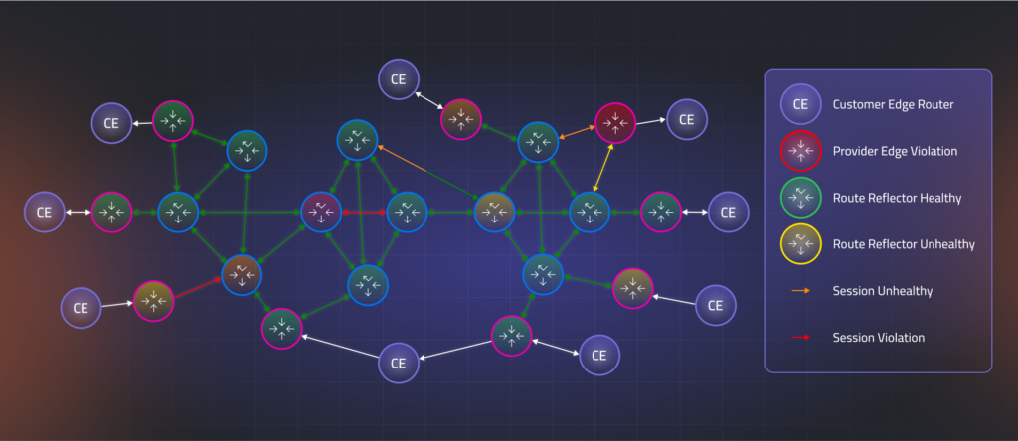
How the Three Strands
Interconnect
Strand 1 provides the foundation: you develop and analyse your skills
Strand 2 supports your performance: you understand the physical and mental demands
Strand 3 gives you context: you see how participation fits into the wider world
All three strands work together in every lesson and activity you experience
Your’ learning in one strand deepens your understanding in the others
For example, improving a skill (Strand 1) requires understanding fitness demands (Strand 2) and ethical practice (Strand 3)
Notes:
Image from: https://www.selector.ai/learning-center/network-visualization-4-ways-to-visualize-computer-networks/

Slide 10
Integrated Learning Activities Across All Strands
Design your own training programme: combines Strand 1 skill goals with Strand 2 fitness principles and Strand 3 ethical considerations
Analyse a professional athlete: examine their technique (Strand 1), training methods (Strand 2), and role in society (Strand 3)
Lead a coaching session: develop others' skills (Strand 1), apply sports science knowledge (Strand 2), and model fair play (Strand 3)
Evaluate a mass participation event: consider participant experiences (Strand 1), health benefits (Strand 2), and social impact (Strand 3)
Reflect on your own participation journey and how all three strands have shaped your understanding and performance

Slide 11

Your Learning Journey Ahead
You will engage with all three strands through
practical participation in physical activities
You will set personal performance goals and work systematically to achieve them
You will develop knowledge that connects theory to your real experiences in sport and movement
You will become a more informed, skilled, and reflective participant in physical activity
Consider this:
How will understanding all three strands help you become a better performer and a more thoughtful participant in physical activity throughout your life?
Notes:
Image from: https://acacia.edu/blog/why-are-goal-setting-strategies-important-for-students-and-how-can-they-be-implemented/

